Slide 1

Logistic Regression Part 2
Dr Mehrdad Ghaziasgar
Senior Lecturer in Computer Science
Department of Computer Science
University of the Western Cape
mghaziasgar@uwc.ac.za

Slide 2
Content
Part 1:
Classification With Logistic Regression
Model Evaluation For Classification
Part 2:
Overfitting and Underfitting
Part 3:
Practical Issues With Classification

Slide 3
Content – Part 2
Overfitting and Underfitting
Introduction
The Concept of Regularization
Regularized Linear Regression
Regularized Logistic Regression

Slide 4
Overfitting and Underfitting
Introduction
Overfitting and Underfitting
Introduction
The Concept of Regularization
Regularized Linear Regression
Regularized Logistic Regression

Slide 5
Introduction
Underfitting and overfitting are problems that can arise that cause a model (either regression or classification) to perform very poorly on test (new) examples
We’ll describe these problems and then describe how we can mitigate them using a technique called “Regularization”
Overfitting and Underfitting

Slide 6


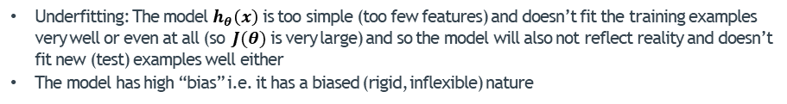





Introduction – Overfitting and Underfitting in Linear Regression
3
3
3
2
2
2
Price $y$
Price $y$
Price $y$
1
1
1
Overfitting and Underfitting
train
1
2
3
1
2
3
test
1
2
3
Size $x$
Size $x$
Size $x$
$$h_{θ}\left(x\right)=θ_{0}+{ θ}_{1}x$$
$$h_{θ}\left(x\right)=θ_{0}+{ θ}_{1}x+{ θ}_{2}x^{2}$$
$$h_{θ}\left(x\right)=θ_{0}+{ θ}_{1}x+{ θ}_{2}x^{2}+{ θ}_{3}x^{3}$$
$+{ θ}_{4}x^{4}$
Underfitting
“High Bias”
Overfitting
“High Variance”
“Just right”
Underfitting: The model $h_{θ}\left(x\right)$ is too simple (too few features) and doesn’t fit the training examples very well or even at all (so $J(θ)$ is very large) and so the model will also not reflect reality and doesn’t fit new (test) examples well either
The model has high “bias” i.e. it has a biased (rigid, inflexible) nature

Slide 7
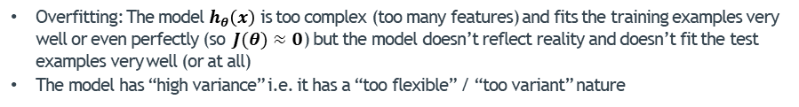
Introduction – Overfitting and Underfitting in Linear Regression
3
3
3
2
2
2
Price $y$
Price $y$
Price $y$
1
1
1
Overfitting and Underfitting
train
1
2
3
1
2
3
test
1
2
3
Size $x$
Size $x$
Size $x$
$$h_{θ}\left(x\right)=θ_{0}+{ θ}_{1}x$$
$$h_{θ}\left(x\right)=θ_{0}+{ θ}_{1}x+{ θ}_{2}x^{2}$$
$$h_{θ}\left(x\right)=θ_{0}+{ θ}_{1}x+{ θ}_{2}x^{2}+{ θ}_{3}x^{3}$$
$+{ θ}_{4}x^{4}$
Underfitting
“High Bias”
Overfitting
“High Variance”
“Just right”
Overfitting: The model $h_{θ}\left(x\right)$ is too complex (too many features) and fits the training examples very well or even perfectly (so $J(θ)≈0$) but the model doesn’t reflect reality and doesn’t fit the test examples very well (or at all)
The model has “high variance” i.e. it has a “too flexible” / “too variant” nature

Slide 8







Introduction – Overfitting and Underfitting in Logistic Regression
$$x_{2}$$
$$x_{2}$$
$$x_{2}$$
$$x_{1}$$
$$x_{1}$$
$$x_{1}$$
Overfitting and Underfitting
$$h_{θ}\left(x\right)=g(θ_{0}+{ θ}_{1}x_{1}+θ_{2}x_{1}^{2}$$
$$+θ_{3}x_{1}^{2}x_{2}^{}+θ_{4}x_{1}^{2}x_{2}^{2}$$
$+θ_{5}x_{1}^{2}x_{2}^{3}+…)$
$$h_{θ}\left(x\right)=g(θ_{0}+{ θ}_{1}x_{1}+{ θ}_{2}x_{2})$$
$$h_{θ}\left(x\right)=g(θ_{0}+{ θ}_{1}x_{1}+{ θ}_{2}x_{2}$$
$$+{ θ}_{3}x_{1}^{2}+{ θ}_{4}x_{2}^{2})$$
Underfitting
“High Bias”
Overfitting
“High Variance”
“Just right”

Slide 9
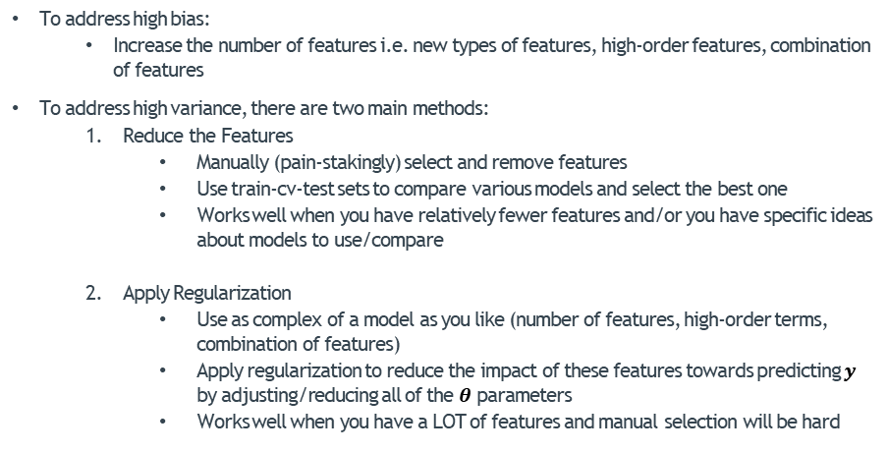
Introduction – Addressing High Bias and Variance
To address high bias:
Increase the number of features i.e. new types of features, high-order features, combination of features
To address high variance, there are two main methods:
Reduce the Features
Manually (pain-stakingly) select and remove features
Use train-cv-test sets to compare various models and select the best one
Works well when you have relatively fewer features and/or you have specific ideas about models to use/compare
Apply Regularization
Use as complex of a model as you like (number of features, high-order terms, combination of features)
Apply regularization to reduce the impact of these features towards predicting $y$ by adjusting/reducing all of the $θ$ parameters
Works well when you have a LOT of features and manual selection will be hard
Overfitting and Underfitting

Slide 10
Overfitting and Underfitting
The Concept of Regularization
Overfitting and Underfitting
Introduction
The Concept of Regularization
Regularized Linear Regression
Regularized Logistic Regression

Slide 11


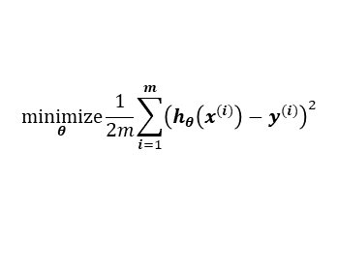

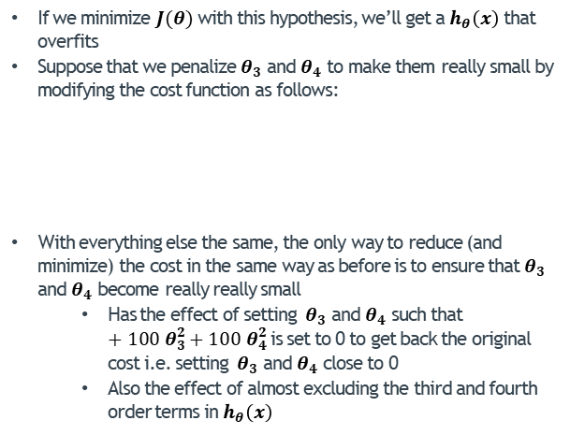


Regularization - Concept
If we minimize $J(θ)$ with this hypothesis, we’ll get a $h_{θ}\left(x\right)$ that overfits
Suppose that we penalize${ θ}_{3}$ and $θ_{4}$ to make them really small by modifying the cost function as follows:
With everything else the same, the only way to reduce (and minimize) the cost in the same way as before is to ensure that${ θ}_{3}$ and $θ_{4}$ become really really small
Has the effect of setting ${ θ}_{3}$ and $θ_{4}$ such that ${+ 100 θ}_{3}^{2}+{100 θ}_{4}^{2}$ is set to 0 to get back the original cost i.e. setting ${ θ}_{3}$ and $θ_{4}$ close to 0
Also the effect of almost excluding the third and fourth order terms in $h_{θ}\left(x\right)$
3
2
Price $y$
1
$$\underset{θ}{minimize}\frac{1}{2m}\sum_{i=1}^{m}{{\left(h_{θ}\left(x^{(i)}\right)−y^{(i)}\right)}^{2}}$$
$${+ 100 θ}_{3}^{2}+{100 θ}_{4}^{2}$$
Overfitting and Underfitting
1
2
3
Size $x$
$$h_{θ}\left(x\right)=θ_{0}+{ θ}_{1}x+{ θ}_{2}x^{2}$$
$$+{ θ}_{3}x^{3}+{ θ}_{4}x^{4}$$
$$≈0$$
$$≈0$$

Slide 12

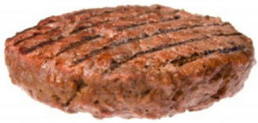



Regularization - Intuition
Intuition 2: Hamburger shop:
As the manager of a hamburger joint, you’re selling 10 200g hamburgers per day @ R10 per hamburger
The “cost” of a burger is:
At this cost, the boss is making a handsome R2000 per day in profits
Life is good
$$\text{Cost}={\text{P}}_{\text{Meat}}\text{+}{\text{P}}_{\text{Veggies}}\text{+}{\text{P}}_{\text{Roll}}$$
Overfitting and Underfitting
$$=3.50+1.20+1.50=\text{R}6.20$$

Slide 13
Regularization - Intuition
Intuition 2: Hamburger shop:
Suddenly, the centre announces that they are supporting “animal rights” or some weird thing like that
They are imposing an extra “cost” on every kg of meat you sell
They will charge you 1cent for every 1g of meat you sell (basically the weight of the meat)
The “cost” of a burger now changes:
Unfortunately, the boss says he’s not willing to accept that much less profit and orders you to reduce the new cost down to R6.50 somehow.
You’ve got to reduce your cost somehow to keep profits constant
The prices at which you’re buying meat, veggies and rolls are also still the same
What can you change to keep the cost the same as it was before?
Reducing the “weight” of the burger
Overfitting and Underfitting
$$\text{Cost}={\text{P}}_{\text{Meat}}\text{+}{\text{P}}_{\text{Veggies}}\text{+}{\text{P}}_{\text{Roll}}+θ_{\text{Meat}}×0.01$$
$$= 3.50+ 1.20 + 1.50 +200×0.01=\text{R}8.20$$

Slide 14




Regularization - Intuition
Intuition 2: Hamburger shop:
Here’s what needs to happen to get the new cost down from R8.20 to R6.50:
$$\text{Cost}={\text{P}}_{\text{Meat}}\text{+}{\text{P}}_{\text{Veggies}}\text{+}{\text{P}}_{\text{Roll}}+θ_{\text{Meat}}×0.01$$
$$6.50= 3.50+ 1.20 + 1.50 +θ_{\text{Meat}}×0.01$$
Overfitting and Underfitting
$$θ_{\text{Meat}}=\frac{6.50 −\left(3.50+ 1.20 + 1.50\right)}{0.01}$$
$$θ_{\text{Meat}}=\frac{6.50 −\left(3.50+ 1.20 + 1.50\right)}{0.01}$$
$$θ_{\text{Meat}}=\text{30}\text{g} \text{of} \text{meat}$$

Slide 15
Regularization - Concept
If we minimize $J(θ)$ with this hypothesis, we’ll get a $h_{θ}\left(x\right)$ that overfits
Suppose that we penalize${ θ}_{3}$ and $θ_{4}$ to make them really small by modifying the cost function as follows:
With everything else the same, the only way to reduce (and minimize) the cost in the same way as before is to ensure that${ θ}_{3}$ and $θ_{4}$ become really really small
Has the effect of setting ${ θ}_{3}$ and $θ_{4}$ such that ${+ 100 θ}_{3}^{2}+{100 θ}_{4}^{2}$ is set to 0 to get back the original cost i.e. setting ${ θ}_{3}$ and $θ_{4}$ close to 0
Also the effect of almost excluding the third and fourth order terms in $h_{θ}\left(x\right)$
3
2
Price $y$
1
$$\underset{θ}{minimize}\frac{1}{2m}\sum_{i=1}^{m}{{\left(h_{θ}\left(x^{(i)}\right)−y^{(i)}\right)}^{2}}$$
$${+ 100 θ}_{3}^{2}+{100 θ}_{4}^{2}$$
Overfitting and Underfitting
1
2
3
Size $x$
$$h_{θ}\left(x\right)=θ_{0}+{ θ}_{1}x+{ θ}_{2}x^{2}$$
$$+{ θ}_{3}x^{3}+{ θ}_{4}x^{4}$$
$$≈0$$
$$≈0$$

Slide 16
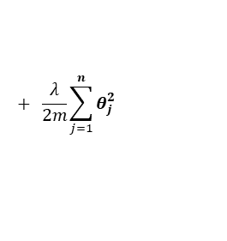

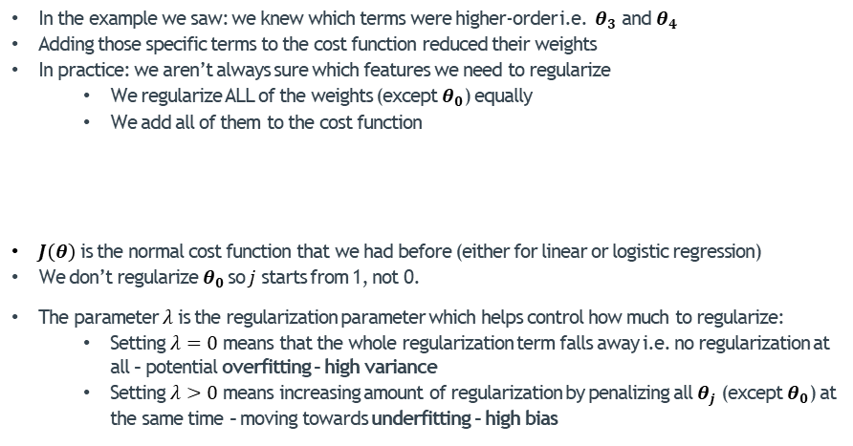
Regularization - Concept
In the example we saw: we knew which terms were higher-order i.e. ${ θ}_{3}$ and $θ_{4}$
Adding those specific terms to the cost function reduced their weights
In practice: we aren’t always sure which features we need to regularize
We regularize ALL of the weights (except $θ_{0}$) equally
We add all of them to the cost function
$J\left(θ\right)$ is the normal cost function that we had before (either for linear or logistic regression)
We don’t regularize${ θ}_{0}$ so $j$starts from 1, not 0.
The parameter $λ$ is the regularization parameter which helps control how much to regularize:
Setting $λ=0$ means that the whole regularization term falls away i.e. no regularization at all – potential overfitting – high variance
Setting $λ>0$ means increasing amount of regularization by penalizing all $θ_{j}$ (except $θ_{0}$) at the same time – moving towards underfitting – high bias
Overfitting and Underfitting
$$+ \frac{λ}{2m}\sum_{j=1}^{n}{θ_{j}^{2}}$$
$$J_{\text{reg}}\left(θ\right)=J(θ)$$

Slide 17
Overfitting and Underfitting
Regularized Linear Regression
Overfitting and Underfitting
Introduction
The Concept of Regularization
Regularized Linear Regression
Regularized Logistic Regression

Slide 18



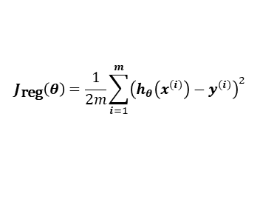
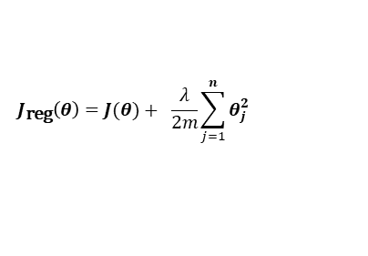
Regularized Linear Regression
What we arrived at previously:
So for linear regression:
$$J_{\text{reg}}\left(θ\right)=J(θ)+ \frac{λ}{2m}\sum_{j=1}^{n}{θ_{j}^{2}}$$
Overfitting and Underfitting
$$J_{\text{reg}}\left(θ\right)=\frac{1}{2m}\sum_{i=1}^{m}{{\left(h_{θ}\left(x^{(i)}\right)−y^{(i)}\right)}^{2}}$$
$$+ \frac{λ}{2m}\sum_{j=1}^{n}{θ_{j}^{2}}$$
$$=\frac{1}{2m}\left[\sum_{i=1}^{m}{{\left(h_{θ}\left(x^{(i)}\right)−y^{(i)}\right)}^{2}}+ λ\sum_{j=1}^{n}{θ_{j}^{2}}\right]$$
$$J_{\text{reg}}\left(θ\right)$$
$$J\left(θ\right)$$

Slide 19
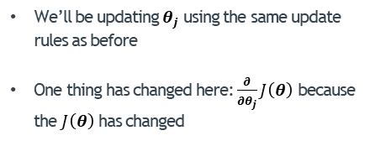


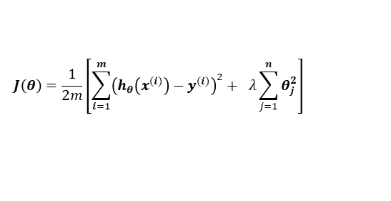
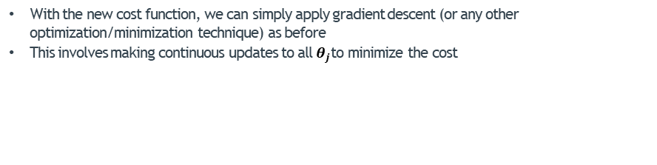
Regularized Linear Regression
With the new cost function, we can simply apply gradient descent (or any other optimization/minimization technique) as before
This involves making continuous updates to all $θ_{j}$to minimize the cost
$$J\left(θ\right)=\frac{1}{2m}\left[\sum_{i=1}^{m}{{\left(h_{θ}\left(x^{(i)}\right)−y^{(i)}\right)}^{2}}+ λ\sum_{j=1}^{n}{θ_{j}^{2}}\right]$$
?
Overfitting and Underfitting
We’ll be updating $θ_{j}$ using the same update rules as before
One thing has changed here: $\frac{∂}{∂θ_{j}}J\left(θ\right)$ because the $J\left(θ\right)$ has changed
Repeat until convergence:
Update all $θ_{j}$ simultaneously:
$$θ_{j}← θ_{j}−α\frac{∂}{∂θ_{j}}J\left(θ\right)$$

Slide 20

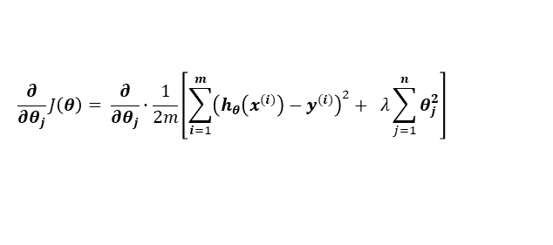
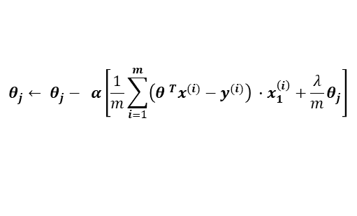
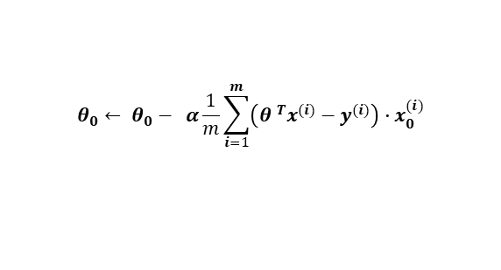
Regularized Linear Regression
For any parameter $θ_{j}$:
$$\frac{∂}{∂θ_{j}}J\left(θ\right)= \frac{∂}{∂θ_{j}}∙\frac{1}{2m}\left[\sum_{i=1}^{m}{{\left(h_{θ}\left(x^{(i)}\right)−y^{(i)}\right)}^{2}}+ λ\sum_{j=1}^{n}{θ_{j}^{2}}\right]$$
Overfitting and Underfitting
Repeat until convergence:
Update all $θ$ simultaneously:
$$θ_{0}← θ_{0}− α\frac{1}{m}\sum_{i=1}^{m}{\left({θ }^{T}x^{(i)}−y^{(i)}\right)∙x_{0}^{(i)}}$$
$$θ_{j}← θ_{j}− α\left[\frac{1}{m}\sum_{i=1}^{m}{\left({θ }^{T}x^{(i)}−y^{(i)}\right)} ∙x_{1}^{\left(i\right)}+\frac{λ}{m}θ_{j}\right]$$

Slide 21



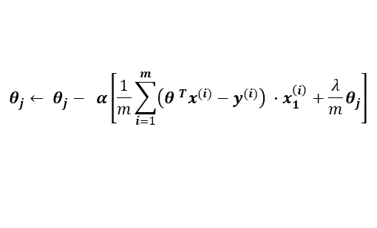
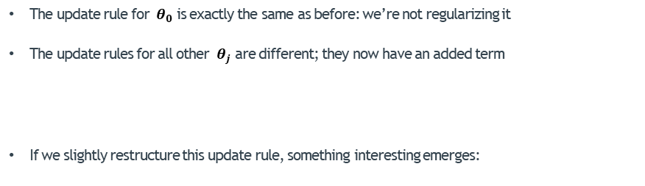
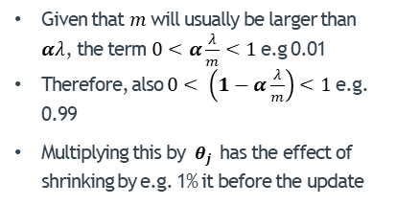
Regularized Linear Regression
The update rule for ${ θ}_{0}$ is exactly the same as before: we’re not regularizing it
The update rules for all other ${ θ}_{j}$ are different; they now have an added term
If we slightly restructure this update rule, something interesting emerges:
$$θ_{j}← θ_{j}− α\left[\frac{1}{m}\sum_{i=1}^{m}{\left({θ }^{T}x^{(i)}−y^{(i)}\right)} ∙x_{1}^{\left(i\right)}+\frac{λ}{m}θ_{j}\right]$$
Overfitting and Underfitting
$$θ_{j}← θ_{j}− α\frac{1}{m}\sum_{i=1}^{m}{\left({θ }^{T}x^{\left(i\right)}−y^{\left(i\right)}\right)} ∙x_{1}^{\left(i\right)}−α\frac{λ}{m}θ_{j}$$
Given that $m$will usually be larger than $αλ$, the term $0<α\frac{λ}{m}<1$ e.g 0.01
Therefore, also $0< \left(1−α\frac{λ}{m}\right)$ $<1$ e.g. 0.99
Multiplying this by $θ_{j}$ has the effect of shrinking by e.g. 1% it before the update
$$θ_{j}← θ_{j}−α\frac{λ}{m}θ_{j}− α\frac{1}{m}\sum_{i=1}^{m}{\left({θ }^{T}x^{(i)}−y^{(i)}\right)} ∙x_{1}^{\left(i\right)}$$
$$θ_{j}←\left(1−α\frac{λ}{m}\right)θ_{j}− α\frac{1}{m}\sum_{i=1}^{m}{\left({θ }^{T}x^{(i)}−y^{(i)}\right)} ∙x_{1}^{\left(i\right)}$$

Slide 22

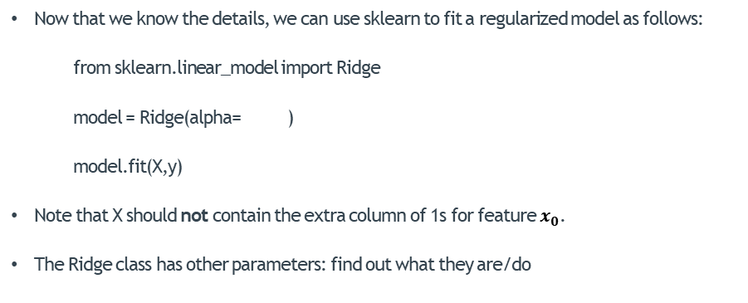
Regularized Linear Regression – Using sklearn
Now that we know the details, we can use sklearn to fit a regularized model as follows:
from sklearn.linear_model import Ridge
model = Ridge(alpha= )
model.fit(X,y)
Note that X should not contain the extra column of 1s for feature $x_{0}$.
The Ridge class has other parameters: find out what they are/do
10
$λ$= 10
Overfitting and Underfitting

Slide 23

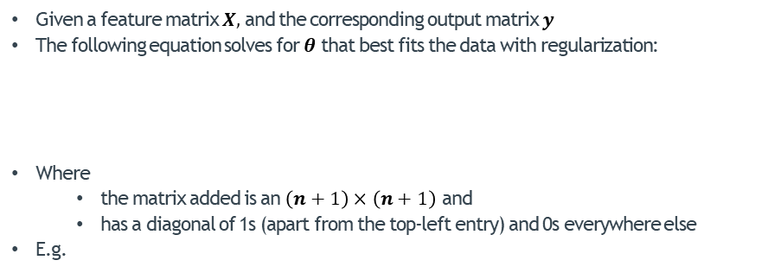

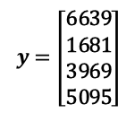
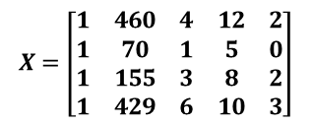
Normal Equation With Regularization
Given a feature matrix $X,$and the corresponding output matrix $y$
The following equation solves for $θ$ that best fits the data with regularization:
Where
the matrix added is an $\left(n+1\right)×\left(n+1\right)$ and
has a diagonal of 1s (apart from the top-left entry) and 0s everywhere else
E.g.
$$θ={\left(X^{T}X+λ\left[\begin{matrix}0 & 0 & 0 & … & 0 \\ 0 & 1 & 0 & … & 0 \\ 0 & 0 & 1 & … & 0 \\ … & … & … & … & … \\ 0 & 0 & 0 & … & 1\end{matrix}\right]\right)}^{−1}X^{T}y$$
Overfitting and Underfitting
#Rms
#Grgs
Regularization matrix for this data:
Size
Age
Price
$$X=\left[\begin{matrix}1 & 460 & 4 & 12 & 2 \\ 1 & 70 & 1 & 5 & 0 \\ 1 & 155 & 3 & 8 & 2 \\ 1 & 429 & 6 & 10 & 3\end{matrix}\right]$$
$$y=\left[\begin{matrix}\text{6639} \\ \text{1681} \\ \text{3969} \\ \text{5095}\end{matrix}\right]$$
$$\left[\begin{matrix}0 & 0 & 0 & 0 & 0 \\ 0 & 1 & 0 & 0 & 0 \\ 0 & 0 & 1 & 0 & 0 \\ 0 & 0 & 0 & 1 & 0 \\ 0 & 0 & 0 & 0 & 1\end{matrix}\right]$$

Slide 24
Overfitting and Underfitting
Regularized Logistic Regression
Overfitting and Underfitting
Introduction
The Concept of Regularization
Regularized Linear Regression
Regularized Logistic Regression

Slide 25


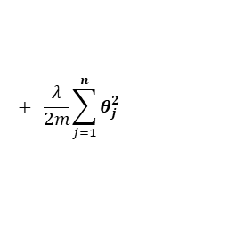
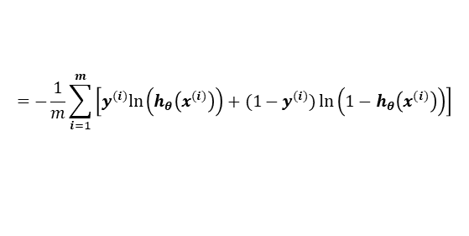

Regularized Logistic Regression
What we arrived at previously:
So for logistic regression:
Where:
$$J_{\text{reg}}\left(θ\right)=J(θ)+ \frac{λ}{2m}\sum_{j=1}^{n}{θ_{j}^{2}}$$
Overfitting and Underfitting
$$=−\frac{1}{m}\sum_{i=1}^{m}{\left[y^{(i)}ln\left(h_{θ}\left(x^{(i)}\right)\right)+(1−y^{(i)})\ln\left(1−h_{θ}\left(x^{(i)}\right)\right)\right]}$$
$$+ \frac{λ}{2m}\sum_{j=1}^{n}{θ_{j}^{2}}$$
$$J_{\text{reg}}\left(θ\right)$$
$$J\left(θ\right)$$
$$h_{θ}\left(x\right)=\frac{1}{1+e^{−{θ }^{T}x}}$$

Slide 26
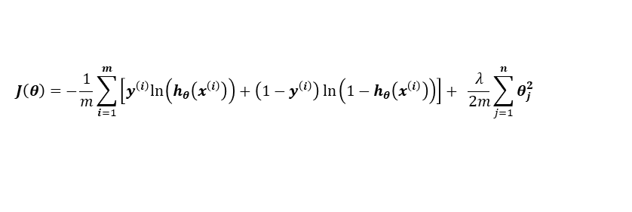

Regularized Logistic Regression
With the new cost function, we can simply apply gradient descent (or any other optimization/minimization technique) as before
This involves making continuous updates to all $θ_{j}$to minimize the cost
$$J\left(θ\right)=−\frac{1}{m}\sum_{i=1}^{m}{\left[y^{\left(i\right)}ln\left(h_{θ}\left(x^{\left(i\right)}\right)\right)+\left(1−y^{\left(i\right)}\right)\ln\left(1−h_{θ}\left(x^{\left(i\right)}\right)\right)\right]}+ \frac{λ}{2m}\sum_{j=1}^{n}{θ_{j}^{2}}$$
?
Overfitting and Underfitting
$$h_{θ}\left(x\right)=\frac{1}{1+e^{−{θ }^{T}x}}$$
We’ll be updating $θ_{j}$ using the same update rules as before
One thing has changed here: $\frac{∂}{∂θ_{j}}J\left(θ\right)$ because the $J\left(θ\right)$ has changed
Repeat until convergence:
Update all $θ_{j}$ simultaneously:
$$θ_{j}← θ_{j}−α\frac{∂}{∂θ_{j}}J\left(θ\right)$$

Slide 27


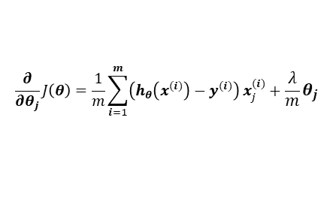
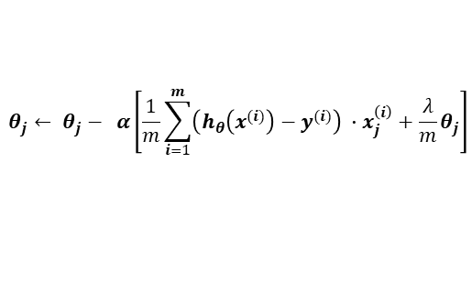
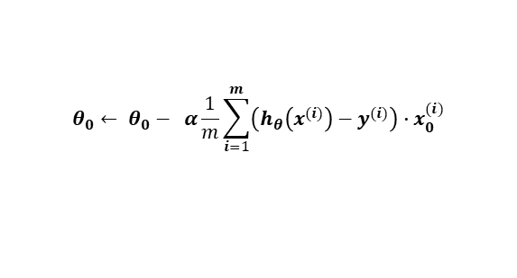
Regularized Logistic Regression
For any parameter $θ_{j}$:
$$\frac{∂}{∂θ_{j}}J\left(θ\right)=\frac{1}{m}\sum_{i=1}^{m}{\left(h_{θ}\left(x^{(i)}\right)−y^{(i)}\right)}x_{j}^{(i)}+\frac{λ}{m}θ_{j}$$
Algorithm appears to be identical to gradient descent for regularized linear regression
It is NOT! The hypothesis here is that of logistic regression
Overfitting and Underfitting
Repeat until convergence:
Update all $θ$ simultaneously:
$$θ_{0}← θ_{0}− α\frac{1}{m}\sum_{i=1}^{m}{\left(h_{θ}\left(x^{(i)}\right)−y^{(i)}\right)∙x_{0}^{(i)}}$$
$$θ_{j}← θ_{j}− α\left[\frac{1}{m}\sum_{i=1}^{m}{\left(h_{θ}\left(x^{(i)}\right)−y^{(i)}\right)} ∙x_{j}^{\left(i\right)}+\frac{λ}{m}θ_{j}\right]$$
$$h_{θ}\left(x\right)=\frac{1}{1+e^{−{θ }^{T}x}}$$

Slide 28
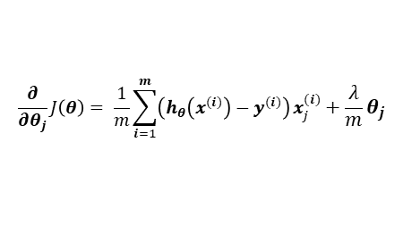
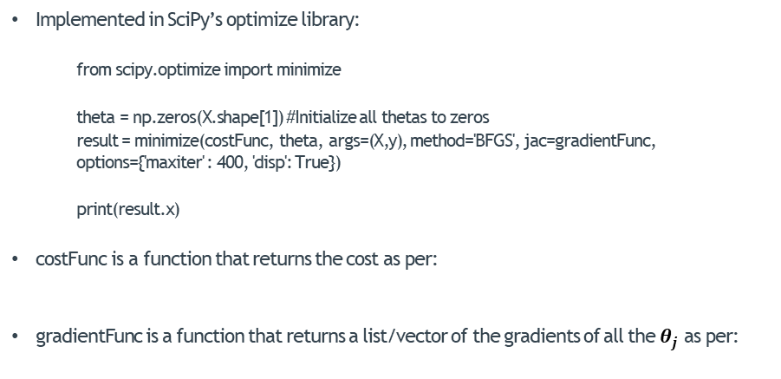
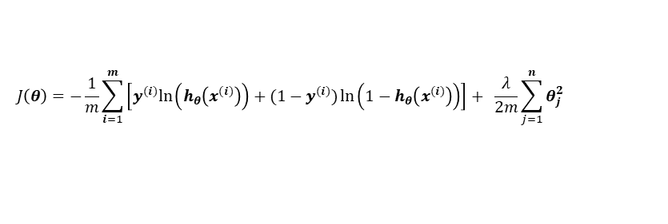
Regularized Logistic Regression Using Adv. Optim. Algorithms
Implemented in SciPy’s optimize library:
from scipy.optimize import minimize
theta = np.zeros(X.shape[1]) #Initialize all thetas to zeros
result = minimize(costFunc, theta, args=(X,y), method='BFGS', jac=gradientFunc, options={'maxiter' : 400, 'disp': True})
print(result.x)
costFunc is a function that returns the cost as per:
gradientFunc is a function that returns a list/vector of the gradients of all the $θ_{j}$ as per:
Overfitting and Underfitting
$$J\left(θ\right)=−\frac{1}{m}\sum_{i=1}^{m}{\left[y^{(i)}ln\left(h_{θ}\left(x^{(i)}\right)\right)+(1−y^{(i)})\ln\left(1−h_{θ}\left(x^{(i)}\right)\right)\right]}+ \frac{λ}{2m}\sum_{j=1}^{n}{θ_{j}^{2}}$$
$$\frac{∂}{∂θ_{j}}J\left(θ\right)= \frac{1}{m}\sum_{i=1}^{m}{\left(h_{θ}\left(x^{(i)}\right)−y^{(i)}\right)}x_{j}^{(i)}+\frac{λ}{m}θ_{j}$$

Slide 29
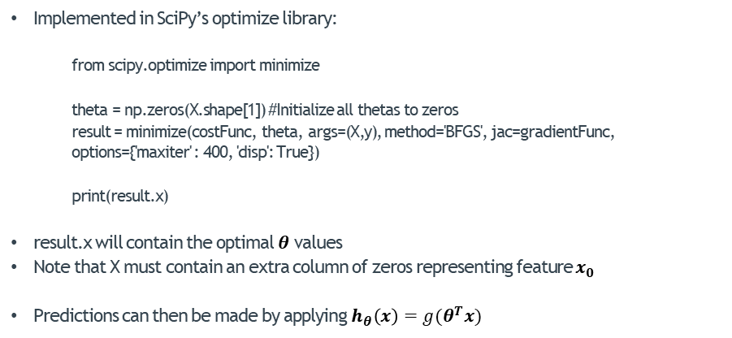
Regularized Logistic Regression Using Adv. Optim. Algorithms
Implemented in SciPy’s optimize library:
from scipy.optimize import minimize
theta = np.zeros(X.shape[1]) #Initialize all thetas to zeros
result = minimize(costFunc, theta, args=(X,y), method='BFGS', jac=gradientFunc, options={'maxiter' : 400, 'disp': True})
print(result.x)
result.x will contain the optimal $θ$ values
Note that X must contain an extra column of zeros representing feature $x_{0}$
Predictions can then be made by applying $h_{θ}\left(x\right)=g(θ^{T}x)$
Overfitting and Underfitting

Slide 30

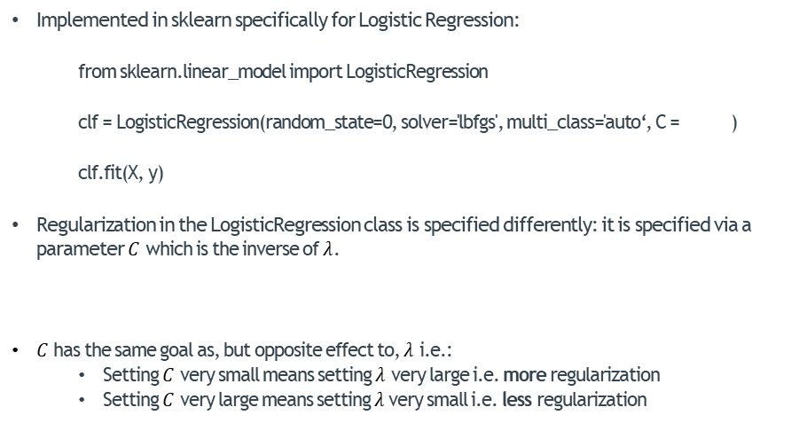



Regularized Logistic Regression Using sklearn
$C=\frac{1}{λ}$= 10
Implemented in sklearn specifically for Logistic Regression:
from sklearn.linear_model import LogisticRegression
clf = LogisticRegression(random_state=0, solver='lbfgs', multi_class='auto‘, C = )
clf.fit(X, y)
Regularization in the LogisticRegression class is specified differently: it is specified via a parameter $C$ which is the inverse of $λ$.
$C$ has the same goal as, but opposite effect to, $λ$ i.e.:
Setting $C$ very small means setting $λ$ very large i.e. more regularization
Setting $C$ very large means setting $λ$ very small i.e. less regularization
So here:
$λ=\frac{1}{C}$= 0.1
10
Overfitting and Underfitting
$$C=\frac{1}{λ}$$
$$λ=\frac{1}{C}$$
so

Slide 31
THE END
Of Logistic Regression Part 2

